Slide 1
Clinical Staff Meeting
March 15, 2023

Slide 2
Agenda
Guardian System
Copy and paste notes - problematic
Demonstration of education website
Asking for feedback on Step by Step guides and standardized orders
I want to include a note Karen just did outlining her work and process using the guide- great example
Feedback on ROC's if we have more analysis
OASIS Tips
Customer Satisfaction scores -
recognizing staff if we have gotten positive comments
Thank you's - Recognition - fun ending - giveaway of dunkin donuts cards

Slide 3
RAVE- Guardian system
https://youtu.be/FkxJCJPfp0g

Slide 4
Preventing Hospitalization and ED Visits Example of being Proactive
focus expedited visit for pacemaker check for change in condition.
pacemaker monitoring device read error 2300 which is system error, writer called medtronic for 2x. writer on
phone 24 minutes and they came to conclusion pacemaker monitor was not working patients daughter will call
cardiologist in AM to get in office pacer check done. furosemide increased by cardiology to 1x dose tonight
then continue MWF. also parameters added to metoprolol to hold if HR under 60, daughter has BP machine,
demonstrated correct use
he is taking lasix tonight, erika the nurse called gave the orders.

Slide 5
Documentation
Copying and pasting notes

Slide 6
Medications
https://drive.google.com/file/d/1G7tLouHmaB0xZkBmpMS-lp30YAw6mkDM/view?usp=share_link

Slide 7
Feedback
Step by Step guides
Standardized Orders

Slide 8
Example of Notes
patient is doing step by step. she told me she has read through the booklet a few times, she feels it is helpful as it keeps her from being "silly
Yesterday,
she is going to use the tracker in the book and she uses the pictures to go along with her PT stretches. we have completed 3 steps so far. i believe there are 4 in the knee.

Slide 9
ROC Review

Slide 10
OASIS E
Resource Guide
Contents

Slide 11
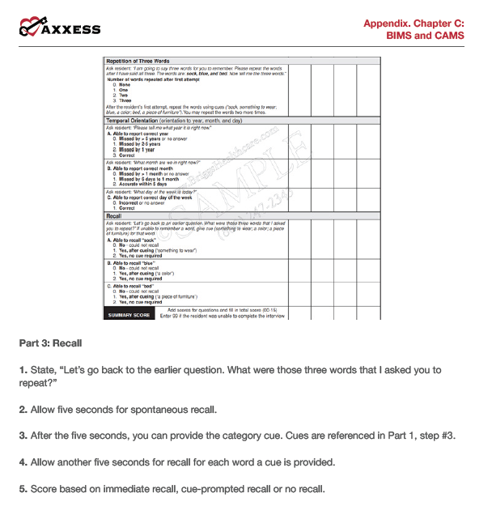
BIMS – Appendix Section of Resource guide

Slide 12
CUE CARDS FOR BIM

Slide 13
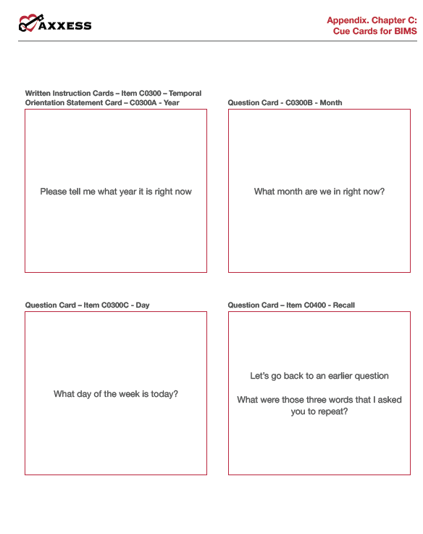

Slide 14
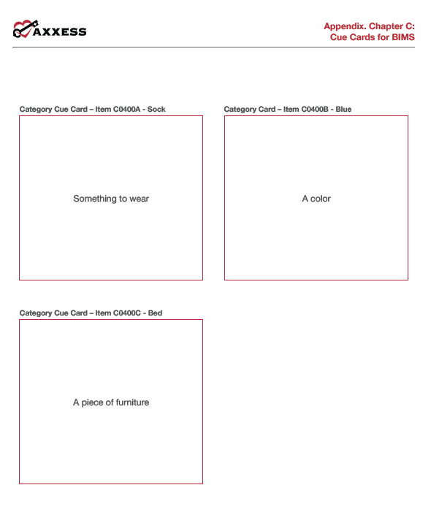

Slide 15
CAM (Confusion Assessment) appendix Section of Resource guide

Slide 16
Depression – Appendix Section of resource guide

Slide 17
Axxess -15 Min Cross Walk
https://video.search.yahoo.com/yhs/search?fr=yhs-infospace-030&ei=UTF-8&hsimp=yhs-030&hspart=infospace&param1=zx7frrj0q5sgmnzohd5wq83b&p=15+min+oasis+assessment&type=ud-c-us--s-p-k54tarxj--exp-none--subid-none#id=1&vid=9671f1437cd613ffc7b19a3810b91dc1&action=click

Slide 18
Assessing Risk of Hospitalization
https://youtu.be/nV_EJ2LprDY

Slide 19
Customer Satisfaction

Slide 20
Customer Satisfaction

Slide 21
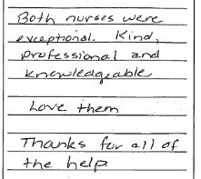
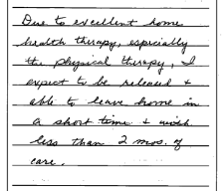
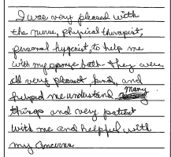
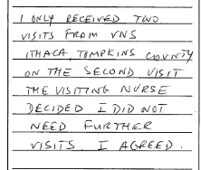
Customer Satisfaction Comments

Slide 22
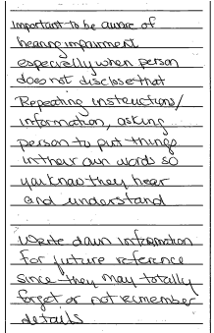
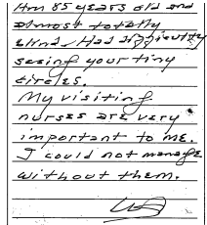
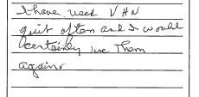
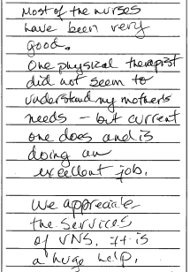
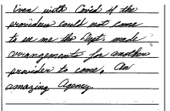
Customer Satisfaction Comments

Slide 23
Thank you Spinning Wheel
https://wheelofnames.com/quv-uqt

